Slide 1

Work plan based on: CRISP-DM & Strawman
Project by: IntegrityM
Members: SeungHeon Han, Yihang Zhao, Yuwen Luo
Predictive Models for Healthcare Fraud
Detection

Slide 2
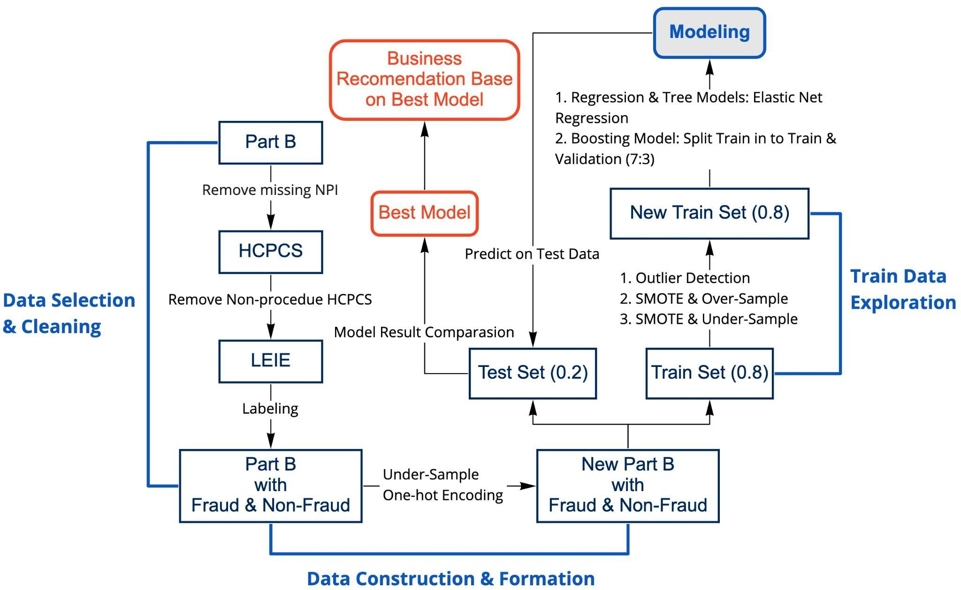
Contents
CRISP-DM & Strawman Work Plan
Business Understanding
Assess Situation
Data Mining Goals/Success Criteria
Project Plan
Initial Assessment of Tools and Techniques
2. Data Preparation
Data Selection
Data Cleaning
Data Construction
Data Formation
3. Train Data Exploration
4. Modleing Techinques
Logistic Model
Decision Tress Model
Random Forest Model
Explainable Boosting Machine (EBM)
eXtreme Gradient Boosting(XGBoost)
5. Model Evaluation & Post Exploration
6. Conclusion
Working Flow Chart of the Project

Slide 3
CRISP-DM & Strawman Work Plan
Business understanding
Background
Emerging technologies like AI and ML can help agencies like CMS to mitigate fraud, waste and abuse, expedite the claims process, reduce errors, and lower the costs of Medicare claims management
Business Objective
Develop a classification predictive model prototype to identify fraudulent patterns and predict fraud cases on CMS healthcare data which can lead to reduced patient harm and financial costs
Success Criteria
The predictive model can be reproduced and replicated in other environments without losing much accuracy
The model can predict fraudulent patterns with high F1 and ROC-AUC scores

Slide 4


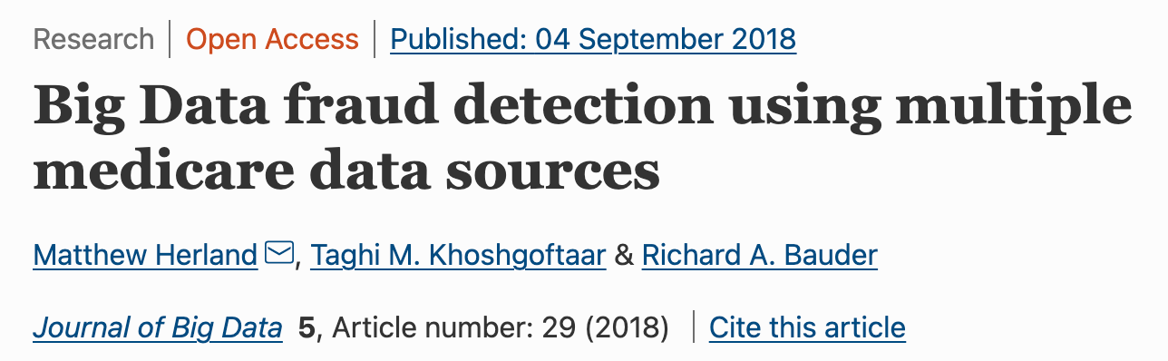
CRISP-DM & Strawman Work Plan
Assess Situation
Resource requirements:
Sufficient datasets: Additional data offered by IntegrityM to improve the problem with Imbalanced data
Reference documennts: Relevant Research Paper, CMS Data Dictionary
Cloud Computing Service: AWS Sage Maker Provide by IntegrityM (Instance type: ml.m5.4xlarge)
Constraints:
Imbalanced data

Slide 5
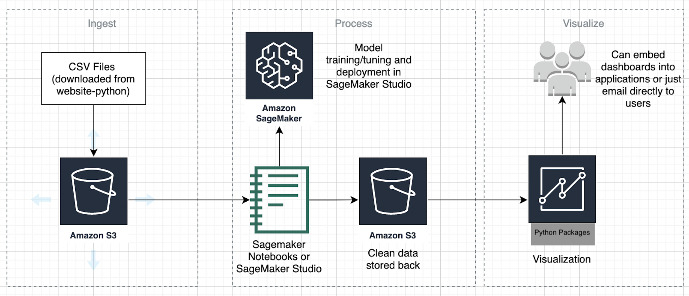
CRISP-DM & Strawman Work Plan
AWS architecture
Seaborn
matplotlib.pyplot
glob

Slide 6
CRISP-DM & Strawman Work Plan
Project Plan
Understanding Business Problems & Goals
Data Collection
Data Wrangling
Data Labeling
Data Partitioning (train, test)
Data Balancing
Data Partitioning (train, validation)
Model Training
Model Evaluation
Post Exploration
Recommendation

Slide 7
2. Data Preparation
Data Selection
Used Features
Rndrng_NPI
Rndrng_Prvdr_Type
Place_Of_Srvc
Tot_Benes
Tot_Srvc
Tot_Bene_Day_Srvcs
Avg_Sbmtd_Chrg
Avg_Mdcr_Pymt_Amt
Avg_Mdcr_Alowd_Amt
Avg_Mdcr_Stdzd_Amt
PartB (2013 - 2019)
[Source - Data.CMS.gov]
Claims information for each procedure that a physician performs within a given year
CSV with 67764122 by 29

Slide 8
2. Data Preparation
Data Selection
The List of Excluded Individuals and Entities (LEIE) - Labels
[Source - Office of Inspector General (OIG)]
LEIE 08-2021 updated
- Most recently updated LEIE database
- REINSTATE & WAIVER = 0 for all the recorded physicians
LEIE Monthly Reinstatements
- Reinsated over 2020/01 - 2021/07
LEIE Plus
- Extra records added to the LEIE datasets

Slide 9
2. Data Preparation
Data Cleaning
Concatenating the Part B datasets across 2013 - 2019
2. Managing invalid and missing values
Provider Gender: 2,943,213 Null Values
Delete the Gender Feature
3. Filtering out the rows that contain HCPCS code related to prescription
Drug Average Sales Pricing File
Non-procedure HCPCS, such as prescription, is out of scope of interests. Only instances matching to the HCPCS codes for procedures are included in the modeling data.
Notes:
10,21,22

Slide 10
2. Data Preparation
Data Construction
Data Labeling Steps
Concatenated the three LEIE datasets
LEIE 08-2021 updated
LEIE Monthly Reinstatements
LEIE Plus
2. Sorted out only the fraud-related exclusion types in LEIE datasets referencing
the Office of Inspector General Acts (OIG)
3. Selected the examples corresponding to the exclusion date until 2020/01/01
4. Labeled each instance of the PartB dataset referencing the NPI column of the LEIE datasets
Fraud = 1
Non-Fraud = 0

Slide 11
OIG Acts
❖1128a1 : Conviction of program-related crimes
❖1128a2 : Conviction relating to patient abuse
❖1128a3 : Felony conviction relating to health care fraud
❖1128a4 : Felony conviction relating to controlled substance
❖1128b1 : Conviction relating to fraud
❖1128b2 : Conviction relating to obstruction of an investigation or audit
❖1128b6 : Claims for excessive charges or unnecessary services and failure of certain organizations to furnish medically necessary services
❖1128b7 : Fraud, kickbacks, and other prohibited activities
❖1128b4 : License revocation or suspension
❖1128b5 : Exclusion or suspension under federal or state health care program
❖1128b8 : Entities controlled by a sanctioned individual
❖1128b15 : Individuals Controlling a Sanctioned Entity
❖1128b16 : Making false statements or misrepresentation of material facts

Slide 12
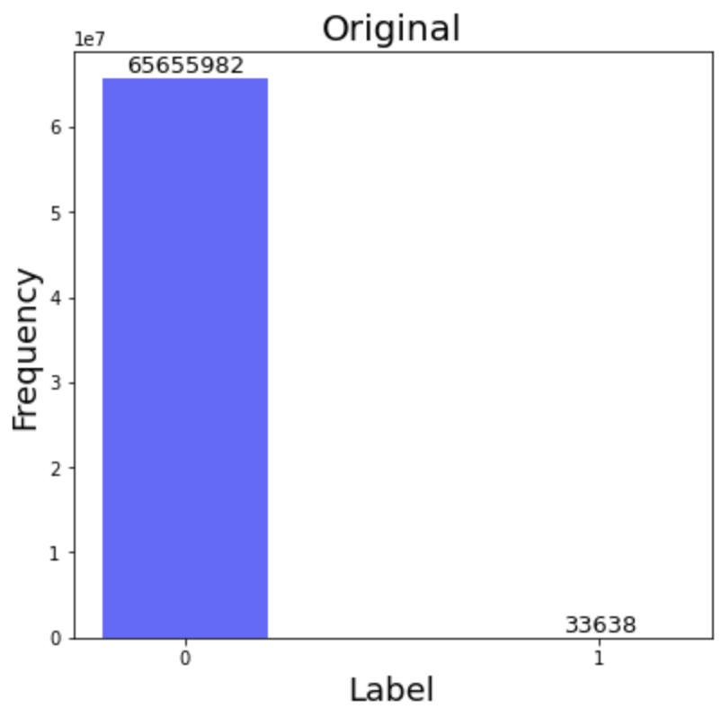
2. Data Preparation
Data Construction
Information on LEIE Data
Total number of LEIE data: 76,005
Invalid NPI: 69,465
Valid NPI: 6,540
Valid NPI matching to every condition: 5,489
Number of Fraud data: 33,638
Fraud: 0.05%
Non-Fraud: 99.95%
Non-Fraud & Fraud Labels after Labeling

Slide 13
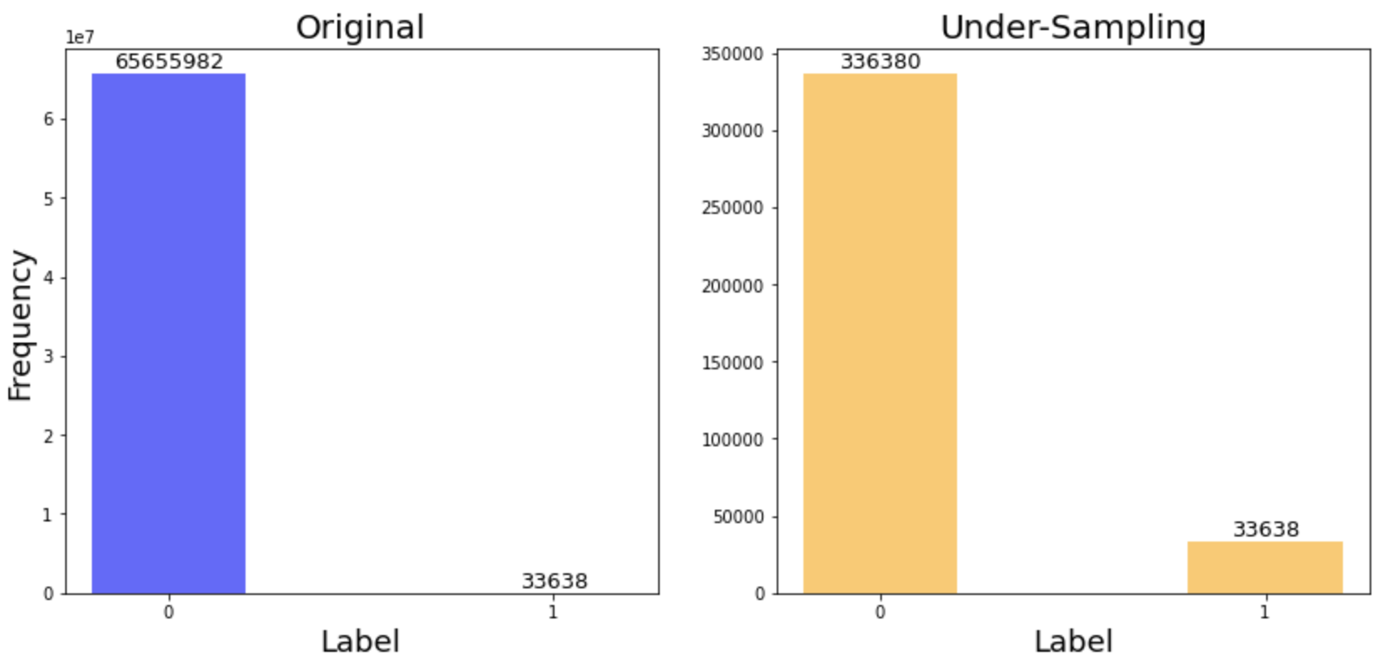
2. Data Preparation
Data Construction
Under-Sampling for Cleaned & Labeled Data
Reduce the size of the majority group to the 10 times of the minority group
Non-Fraud & Fraud Labels after
Under-Sampling
Fraud: 0.05%
Non-Fraud: 99.95%
Fraud: 9.09%
Non-Fraud: 90.91%

Slide 14
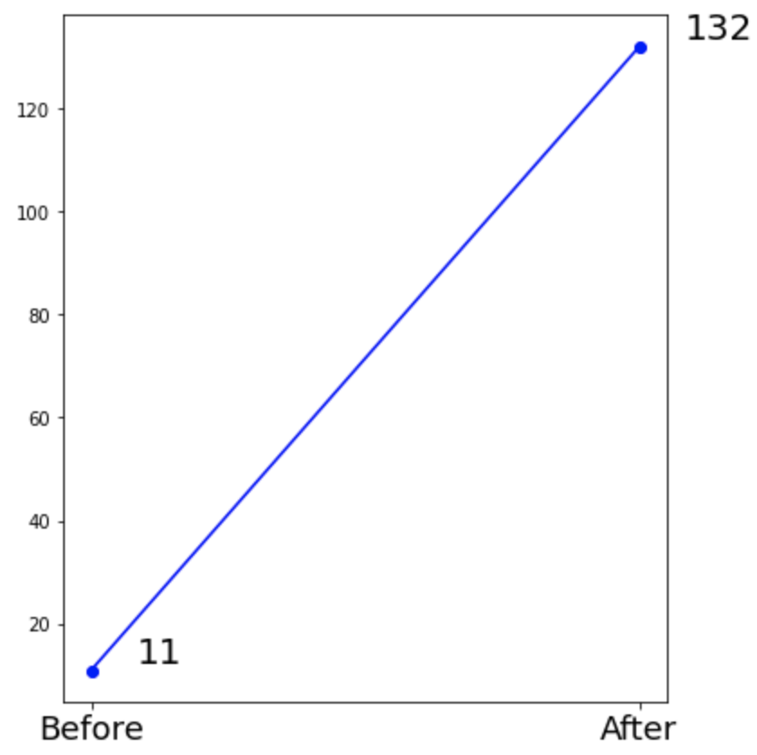
2. Data Preparation
Data Construction
One-Hot Encoding
Converting the nominal variables to dummy variables
Place_of_Service
Provider Type
Total Number of Features
11 -> 132
Total Number of Features after One-Hot Encoding

Slide 15
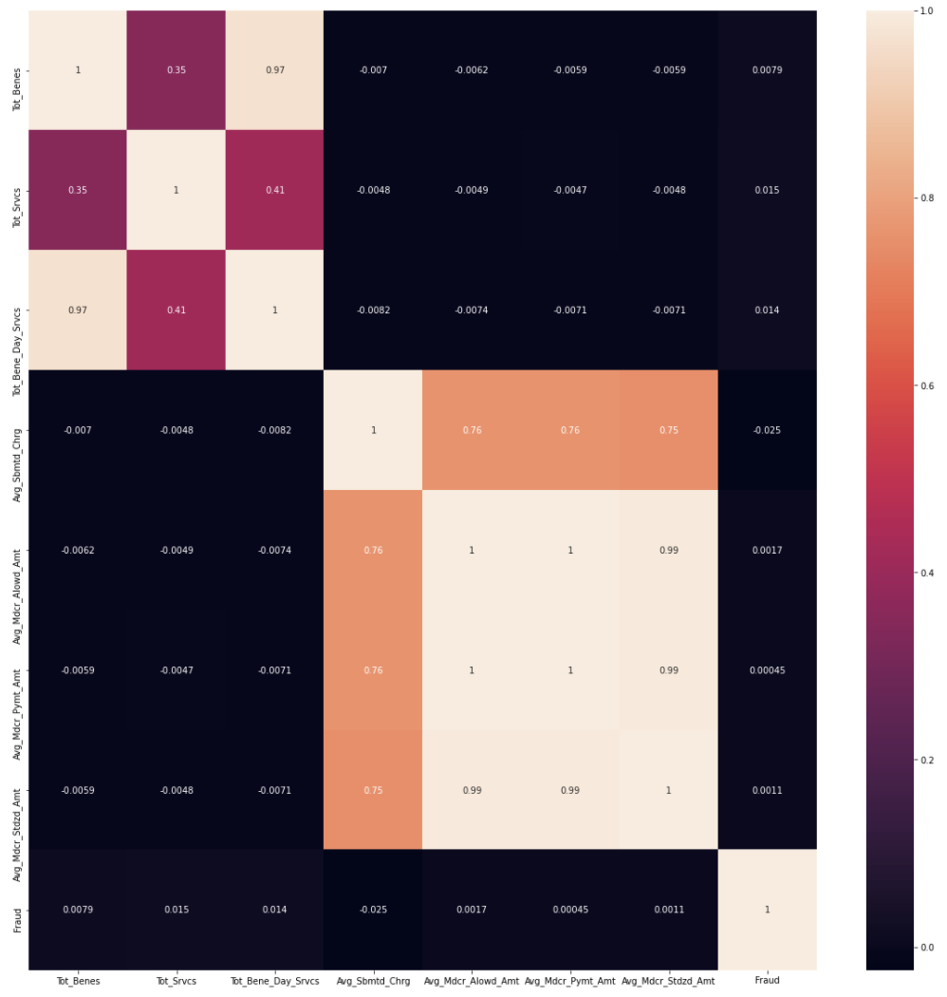
3. Train Data Exploration
Correlation & Heatmap
Variables | Correlation
Tot_Bene_Day_Srvcs & Tot_Benes | 0.97
Avg_Mdcr_Alowd_Amt & Avg_Mdcr_Stdzd_Amt | 0.99
Avg_Mdcr_Pymt_Amt & Avg_Mdcr_Stdzd_Amt | 0.99
Avg_Mdcr_Pymt_Amt & Avg_Mdcr_Alowd_Amt | 1

Slide 16
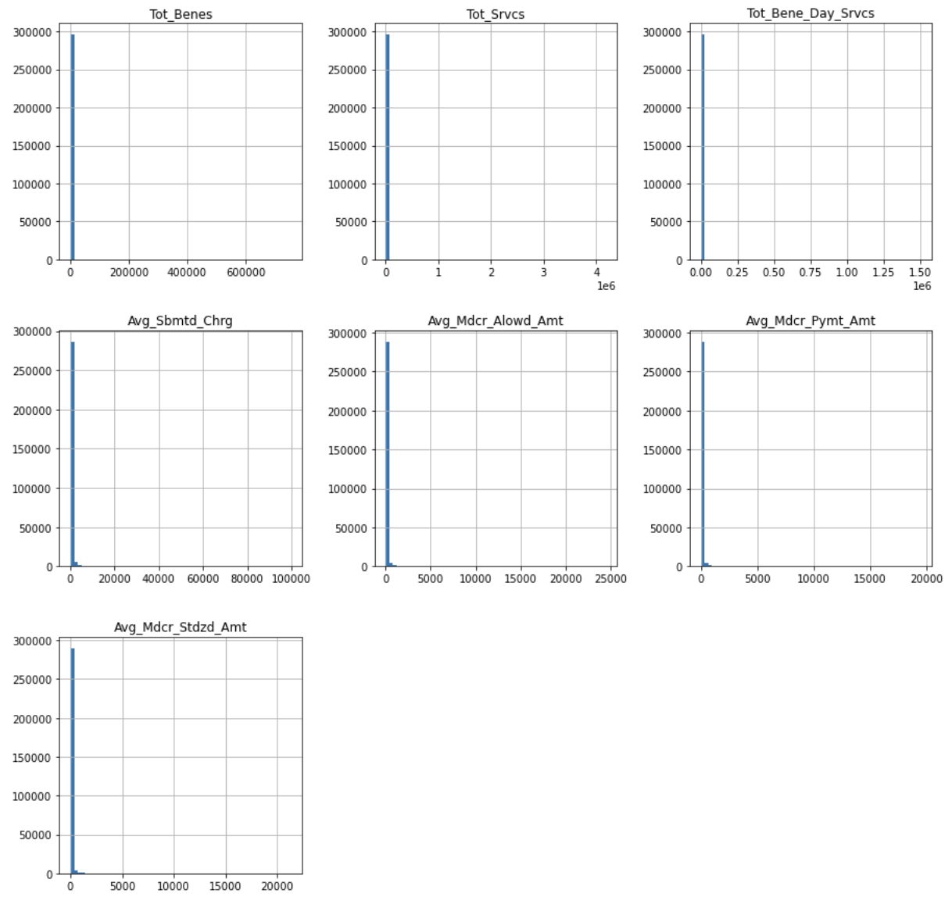
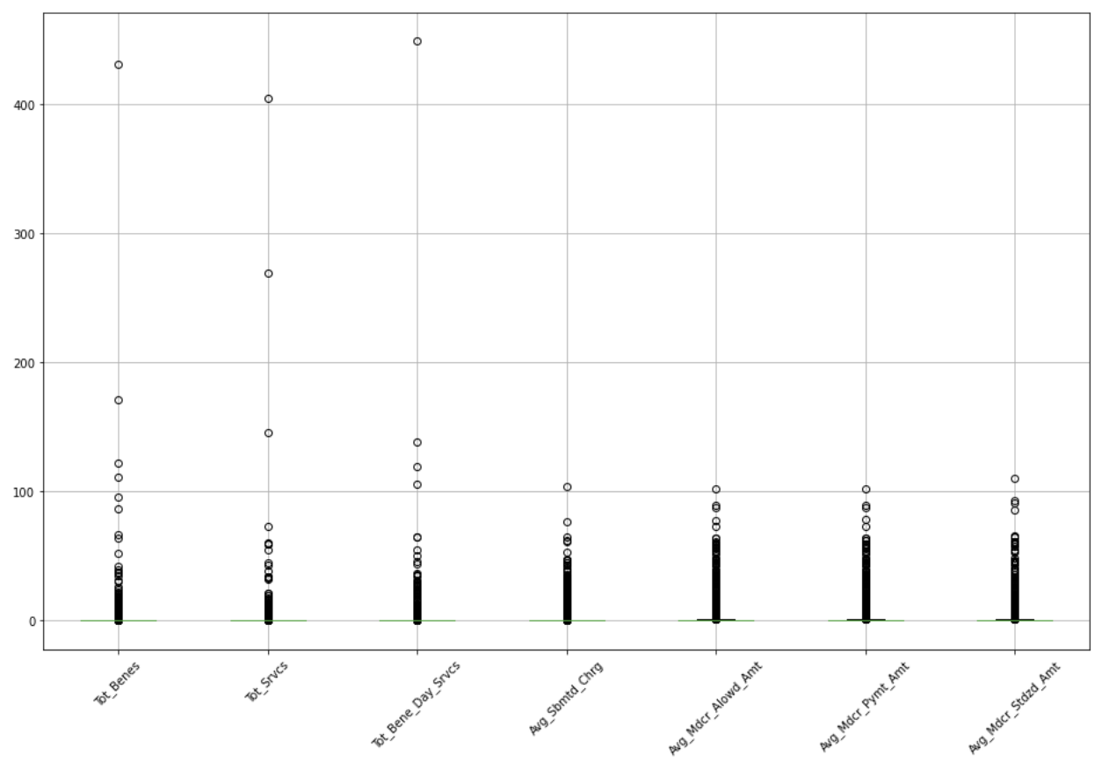
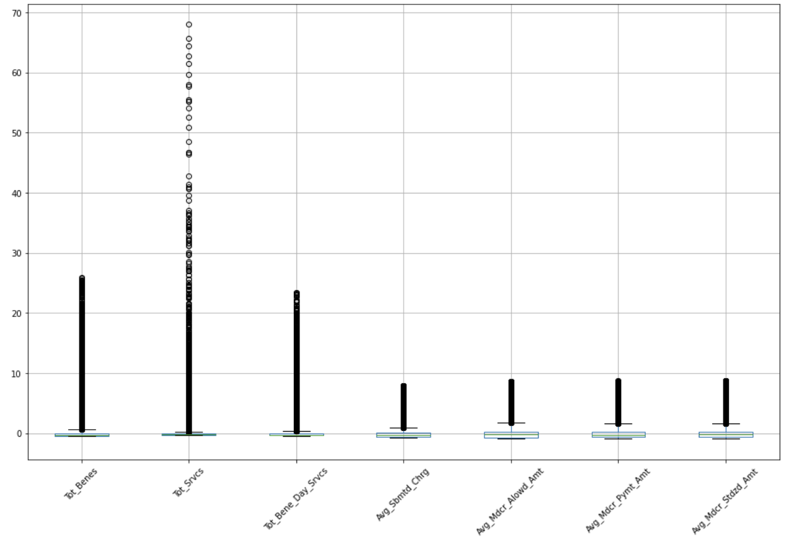
3. Train Data Exploration
Data Distribution
Data Distribution
Skewed to the right
Definition of Outlier:
|z-score| > 3
Extremely skewed to the right
log-transformation can be needed for linear models

Slide 17
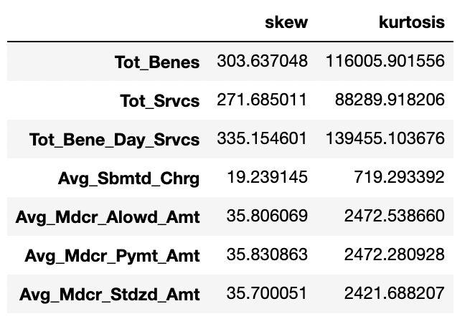
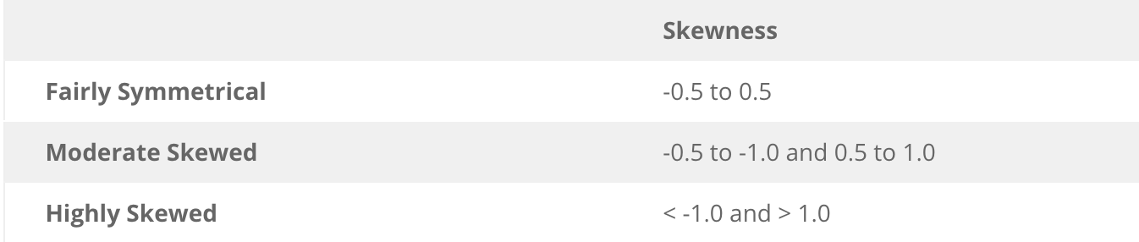
3. Train Data Exploration
Skeweness

Slide 18
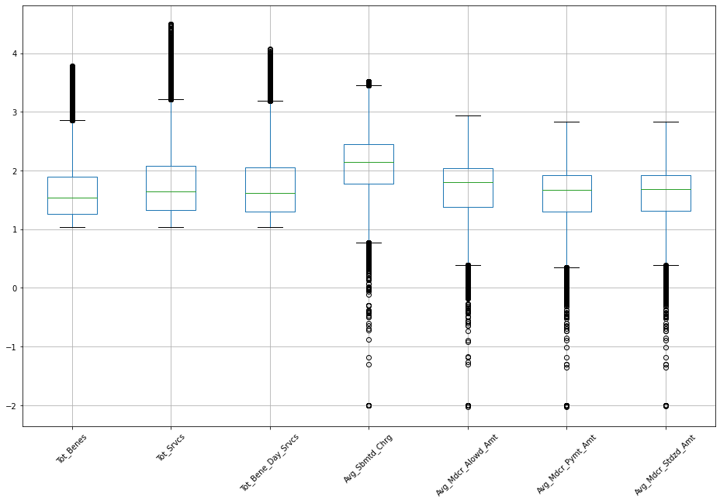
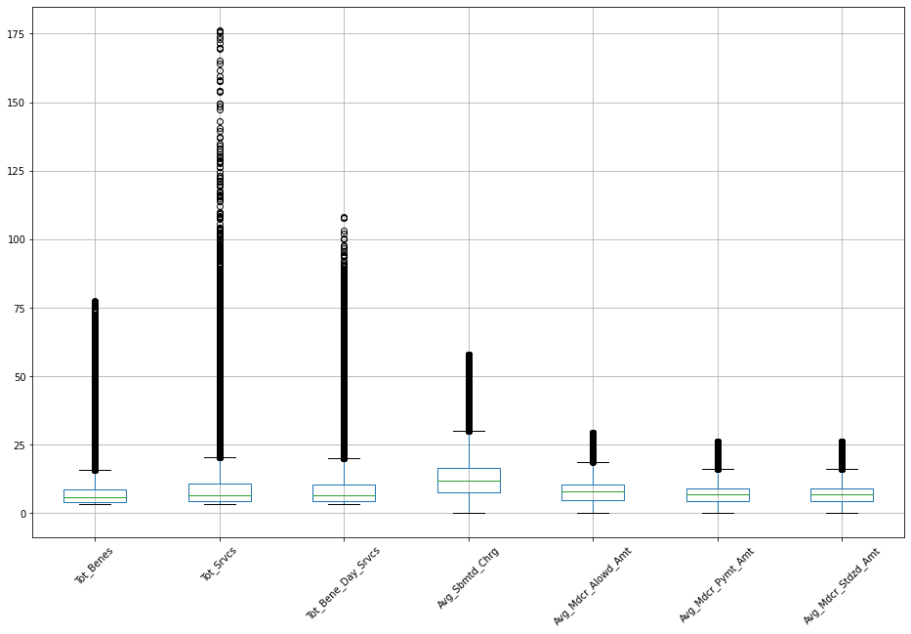
3. Train Data Exploration
Log_10 / Square Root Transformation
Log_10 Transformation
Sqaure_root Transformation

Slide 19
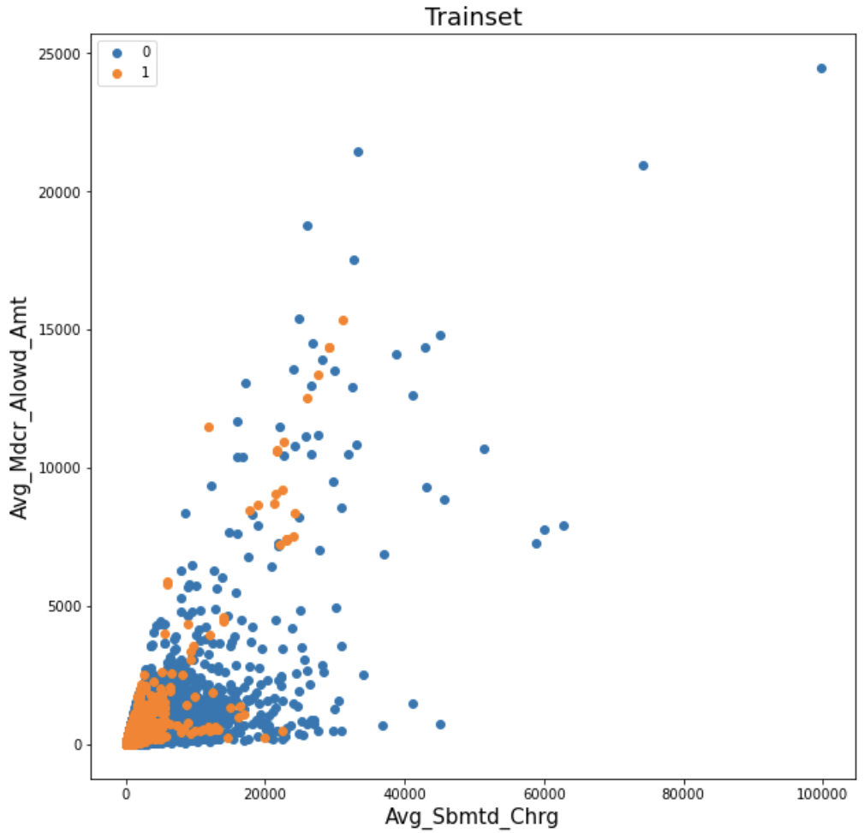
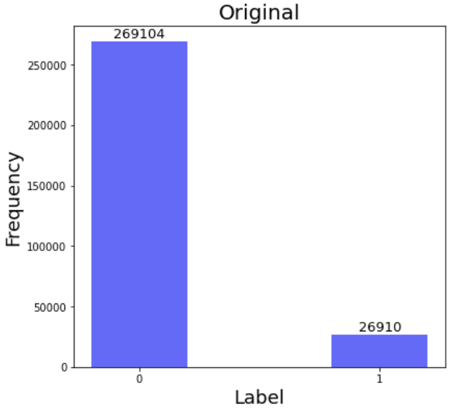
3. Train Data Exploration
Over-Sampling & SMOTE
Non-Fraud & Fraud Label
Before Over-Sampling

Slide 20
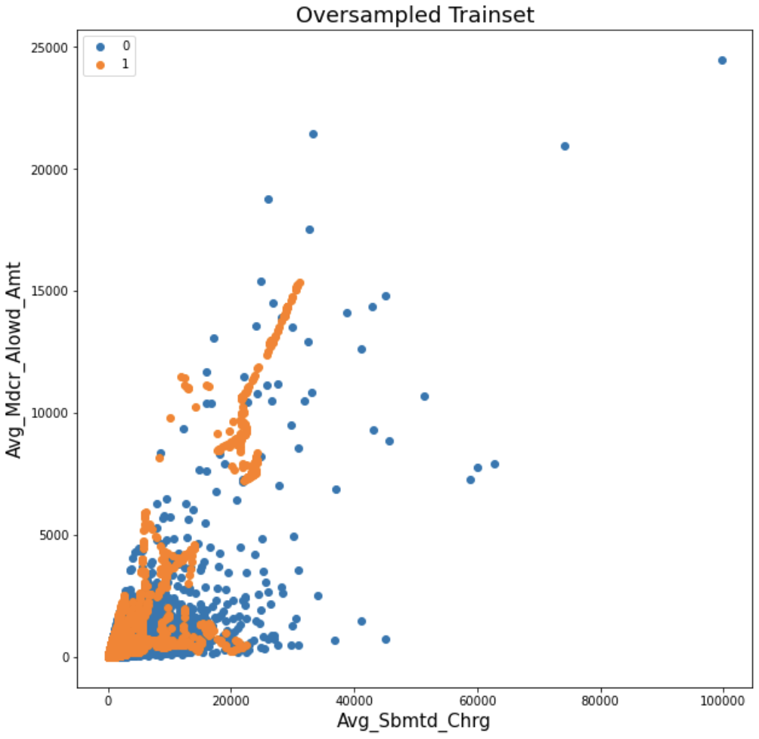
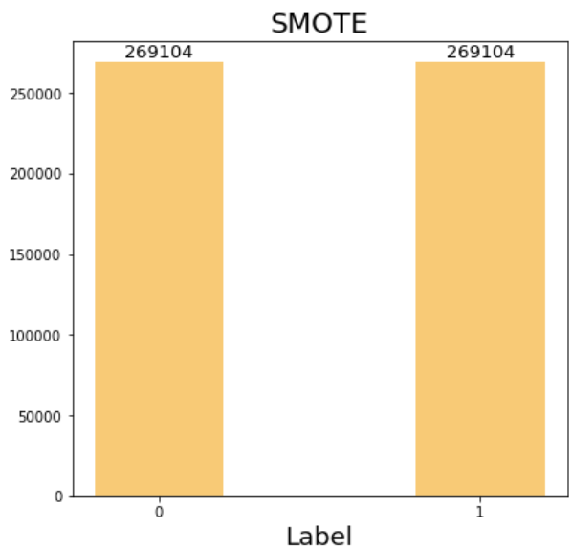
3. Train Data Exploration
Over-Sampling & SMOTE
Non-Fraud & Fraud Label
After Over-Sampling

Slide 21
4. Modeling Techique
Select Modeling Techniques
Modeling Technique
- Logistic regression
Random Forest
Decision Tree
eXtreme Gradient Boosting（XGBoost）
Explainable Boosting Machine(EBM)
Modeling Assumption
The random errors have a constant standard deviation
The random errors follow a normal distribution
The data are randomly sampled from the process
2) Generate Test Design
Splitting the whole dataset into train and test sets with 8:2 ratio
Using a stratified random sampling technique to evenly assign the fraud cases to train and test sets.
Evaluation Metrics
Accuracy
AUC
F1-score
Logloss
MSE

Slide 22
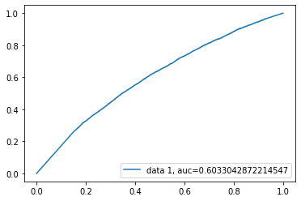
4. Modeling Techique
Logistic Regression (Continuous Variables)
Intercept | Tot_Benes (coefficient) | Tot_Srvcs (coefficient) | Tot_Bene_Day_Srvcs (coefficient) | Avg_Sbmtd_Chrg (coefficient) | Avg_Mdcr_Alowd_Amt (coefficient)
-2.52 | -0.69 | 0.43 | 0.53 | -0.95 | 0.96

Slide 23
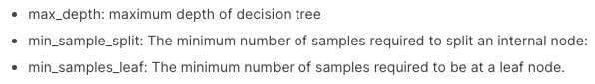
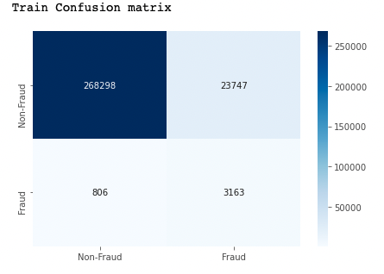
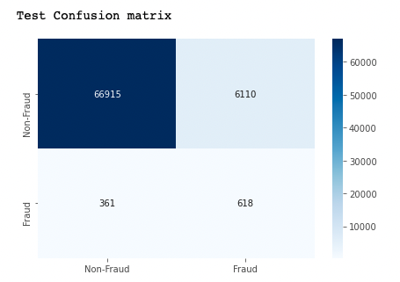
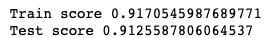
4. Modeling Techique
Decision Tree (Pre-Prunning)
Max_depth | Min_sample_leaf | Min_sample_split
12 | 2 | 4

Slide 24
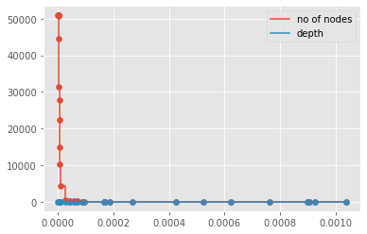
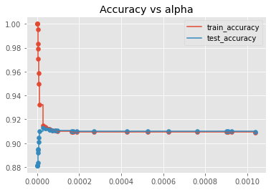
4. Modeling Techique
Decision Tree (cost complexity prunning)
Conclusion
There are several prunning techniques.
We are choosing to find the right parameter of alpha.

Slide 25
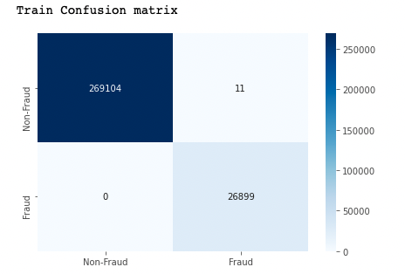
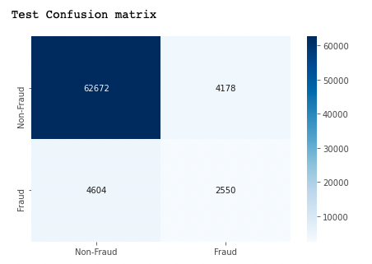
4. Modeling Techique
Decision Tree (post - prunning)
Alpha | Test Score
8.45e-07 | 0.877

Slide 26
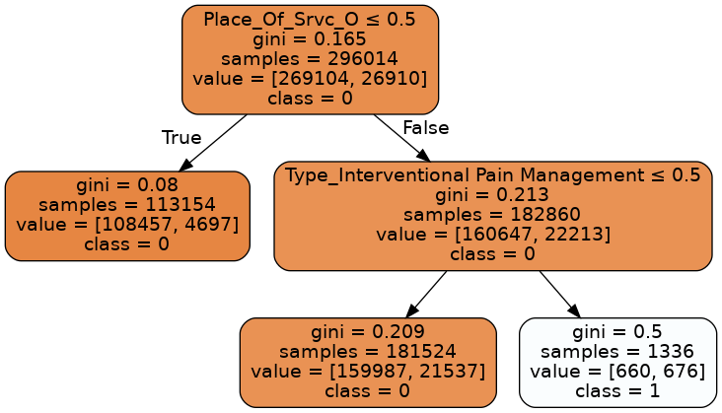
4. Modeling Techique
Decision Tree (post - prunning)
Check the group of provideras whose type is ‘Interventional Pain Management’ and provide serive ‘on Facility’ to detect more fraud incidence

Slide 27
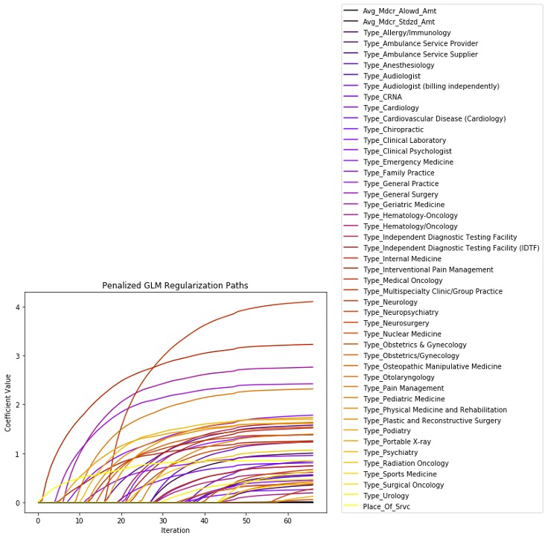
4. Modeling Techique
Random Forest (Feature Selection)
Train Elastic Net Logistic GLM:
Split the Train Set into train & validation sets with 7:3 ratio
Hyperparameters Tuning: Random Grid Search using H2O Model (H2O is a Java-based software for data modeling and general computing. )
Establish benchmark feature selection: glm_selected

Slide 28
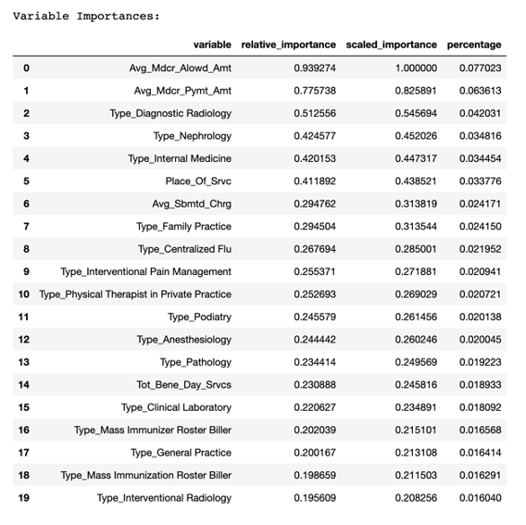
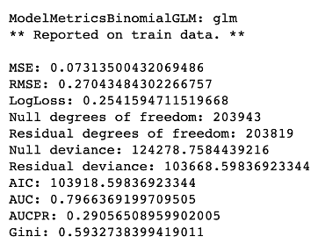
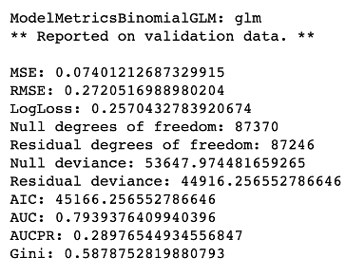
4. Modeling Techique
Random Forest (Feature Selection)
Elastic Net Logistic Model Result

Slide 29
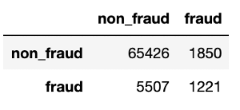
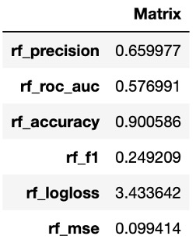
4. Modeling Techique
Random Forest
Random Forest Model on Selected Features:
Model Result on Test Data

Slide 30
4. Modeling Techique
Explainable Boosting Machine (EBM)
Hyperparameters:
Random Grid Search
Running Time: 2531.81 sec
Selected Parameters:
Performance
Average five-folds evaluation
Parameter | Value | Parameter | Value
n_jobs | 4 | outer_bags | 4
early_stopping_rounds | 100 | inner_bags | 0
random_state | 1234 | learning_rate | 0.001
max_bins | 128 | validation_size | 0.25
max_interaction_bins | 16 | min_samles_leaf | 10
interactions | 15 | max_leaves | 3
ACC | AUC | F1-Score | Logloss | MSE
0.909 | 0.792 | 0.350 | 0.339 | 0.102
cut-off = 0.44 |  | Prediction
 |  | 1 (Fraud) | 0 (Non-fraud)
Actual | 1 (Fraud) | 3,159 | 3,569
 | 0 (Non-Fraud) | 8,351 | 58,925

Slide 31
4. Modeling Techique
eXtreme Gradient Boosting (XGB)
Hyperparameters:
Random Grid Search
Running Time: 340 sec
Selected Parameters:
Performance
Average five-folds evaluation
Parameter | Value | Parameter | Value
booster | GBT | learning_rate | 0.5
evaluation_metric | auc | max_depth | 7
nthread | 4 | reg_alpha | 0.005
min_child_weight | 1 | reg_lambda | 0.005
colsample_bytree | 0.7 | subsample | 0.9
colsample_bylevel | 0.9 | gamma | 0.2
ACC | AUC | F1-Score | Logloss | MSE
0.914 | 0.836 | 0.411 | 0.274 | 0.076
cut-off = 0.2 |  | Prediction
 |  | 1 (Fraud) | 0 (Non-fraud)
Actual | 1 (Fraud) | 3,163 | 3,565
 | 0 (Non-Fraud) | 5,686 | 61,590

Slide 32
5. Model Evaluation & Post Exploration
Evaluation on Test Set
Evalueation Matrix on Test Set | Logistic Regression | Random Forest | Decision Tree | eXtreme Gradient Boosting (XGBoost) | Explainable Boosting Machine(EBM)
Accuracy | 0.70 | 0.90 | 0.88 | 0.914 | 0.909
AUC | 0.603 | 0.57 | 0.655 | 0.836 | 0.792
F1 | 0.198 | 0.24 | 0.367 | 0.411 | 0.350
Log Loss | 10.34 | 3.42 | 4.099 | 0.274 | 0.3390
MSE | 0.299 | 0.09 | 0.123 | 0.076 | 0.102
Conclusion:
XGBoost performs best
AUC: Area under the ROC Curve. AUC of 0.5 suggests no discrimination, 0.7 to 0.8 is considered acceptable, 0.8 to 0.9 is considered excellent
F1-score: measure of a model’s accuracy on a dataset. It is used to evaluate binary classification systems, which classify examples into ‘positive’ or ‘negative’.
The harmonic mean of the model’s precision and recall.

Slide 33
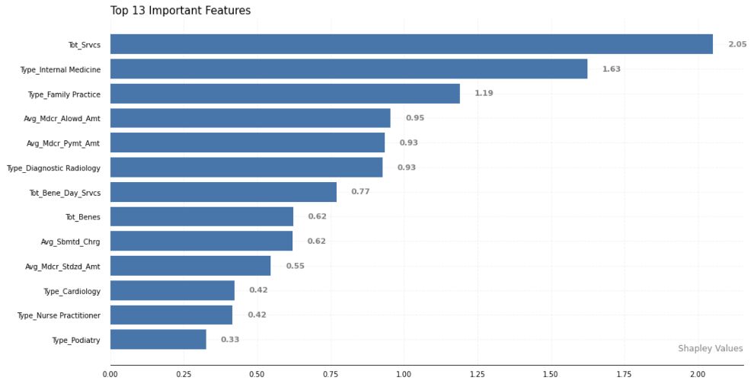
5. Model Evaluation & Post Exploration
eXtreme Gradient Boosting (XGB)
Global Feature Importance based on Shapley Values
- Features with the shapley values placed above 90th percentile:
1. Tot_Srvcs
2. Type_Internal Medicine
3. Type_Family Practice
4. Avg_Mdcr_Alowd_Amt
5. Avg_Mdcr_Pymt_Amt
6. Type_Diagnostic Radiology
7. Tot_Bene_Day_Srvcs
8. Tot_Benes
9. Avg_Sbmtd_Charg
10. Avg_Mdcr_Stdzd_Amt
11. Type_Cardiology
12. Type_Nurse Practitioner
13. Type_Proiatry

Slide 34
6. Conclusion
Models Objective
Develop an XGBoost model to identify fraudulent patterns and predict fraud cases on the CMS healthcare data.
Models Evaluation
XGBoost model can reduce fraud, waste, and abuse with a high AUC score of 0.836 and an F1 score of 0.411.
Models Result: Predicted Fraudulent Patterns List
Rank of Importance | Variables Name | Data Dictionary
1 | Tot_Srvcs | Number of Services
2 | Type_Internal Medicine | Internal Medicine
3 | Type_Family Practice | Family Practice
4 | Avg_Mdcr_Alowd_Amt | Average Medicare Allowed Amount
5 | Avg_Mdcr_Pymt_Amt | Average Medicare Payment Amount
6 | Type_Diagnostic Radiology | Diagnostic Radiology
7 | Tot_Bene_Day_Srvcs | Number of Distinct Medicare Beneficiary/Per Day Services
8 | Tot_Benes | Number of Medicare Beneficiaries
9 | Avg_Sbmtd_Charg | Average Submitted Charge Amount
10 | Avg_Mdcr_Stdzd_Amt | Average Medicare Standardized Payment Amount
11 | Type_Cardiology | Cardiology
12 | Type_Nurse Practitioner | Nurse Practitioner
13 | Type_Proiatry | Proiatry
Fraudulent Patterns Facts
Internal Medicine: Physician Agrees to Pay $640,000 to Resolve Allegations of Anti-Kickback Violations. October 12, 2021
Diagnostic Radiology: Long Island Radiologist to Pay Over $15 Million to Settle False Claims Act Allegations
Nurse Practitioner: Nurse Practitioner Charged in Alleged $2.3 Million Health Care Fraud Scheme. August 16, 2021
Unbundling a single procedure so that it's billed for in multiple parts.
Upcoding an item on the bill to a more complex procedure than provided.

Slide 35
6. Conclusion
Limitation
Imbalanced Data The dataset includes more than 99% of non-faud data points. This obstructs our data-processing and modeling steps. Future team could apply string matching method (like Fuzzywuzzy package in Python) to receive more fraud labels from LEIE Plus.
Insufficient Data
Failed to obtain enough training data thoroughly. The medical history is incomplete, The results contain misjudgment and can only be an assistant tool for data analysts for efficiency.
Under-Sampling
The observations matching the non-fraud label are randomly selected and deleted so every process is made up of different examples.
Labeling
During the process of manual labeling, different data analysts have different concepts of abnormal and they are constrained by their domain knowledge of disease or prescription, which will result in the inconsistency of results.

Slide 36
Q & A
Q & A

Slide 37
Appendix
Medicare Provider Utilization and Payment Data: Part B Physician and Other Supplier: Medicare Physician & Other Practitioners - by Provider and Service
https://data.cms.gov/provider-summary-by-type-of-service/medicare-physician-other-practitioners/medicare-physician-other-practitioners-by-provider-and-service
Medicare Provider Utilization and Payment Data: Part D Prescriber: Medicare Part D Prescribers - by Provider and Drug
https://data.cms.gov/provider-summary-by-type-of-service/medicare-part-d-prescribers/medicare-part-d-prescribers-by-provider-and-drug/data/2019
Medicare Provider Utilization and Payment Data: Referring Durable Medical Equipment, Prosthetics, Orthotics and Supplies (DMEPOS) : Medicare Durable Medical Equipment, Devices & Supplies - by Referring Provider and Service
https://data.cms.gov/provider-summary-by-type-of-service/medicare-durable-medical-equipment-devices-supplies/medicare-durable-medical-equipment-devices-supplies-by-referring-provider-and-service
LEIE 08-2021
https://oig.hhs.gov/exclusions/exclusions_list.asp
LEIE Monthly Reinstatements
https://oig.hhs.gov/exclusions/exclusions_list.asp
Drug Average Sales Pricing File
https://www.cms.gov/Medicare/Medicare-Fee-for-Service-Part-B-Drugs/McrPartBDrugAvgSalesPrice/2019ASPFiles
Office of Inspector General Acts (OIG Acts 1128)
https://www.ssa.gov/OP_Home/ssact/title11/1128.htm

Slide 38
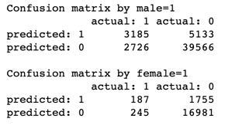
Appendix
Identifying Potential Disparate Impact on Gender (XGB)
Protected Group: Female Providers
Referenced Group: Male Providers
Adverse Impact Ratio (AIR)
Air for Male vs. Female: 1.075 (> 0.8)
Female Proportion Accepted: 0.899
Male Proportion Accepted: 0.836
F1-Score: 0.4062
Cut-off: 0.21

